Slide 1
ABAP Part I
Lesson 05: Common Control statements – Self Study

Slide 2
Lesson Objectives
In this lesson, you will learn about:
If Statement and Case Statement
The exit Statement
The do and the While statement
The continue and Check statement
Notes:
Explain the lesson coverage

Slide 3
IF statement
The if statement in ABAP/4 has relational operators for equality and inequality and special relational operators for string comparisons and bit masks.
Syntax:
if [not] exp [ and [not] exp ] [ or [not] exp ].
---
[elseif exp.
---]
[else.
---]
endif.
where:
exp is a logical expression that evaluates to a true or false condition
--- represents any number of lines of code.
Even zeros lines are allowed
Notes:
The following points apply:
Every if must have a matching endif
else and elseif are optional
Parenthesis can be used. Each parenthesis must be separated by a space. For example, if ( f1 = f2 ) or ( f1 = f3 ) is correct, and if (f1 = f2 ) or (f1 = f3) is incorrect
Variables can be compared with blanks or zeros using the addition is initial.
For example, If f1 is initial will be true if f1 is type c and is blank.
If f1 is any data type, the statement is true if f1 contains zeros
To accomplish negation, not must precede the logical expression.
For example, if not f1 is initial is correct.
if f1 is not initial is incorrect.
Variables can be compared with nulls using the addition is null. For example, if f1 is null.

Slide 4
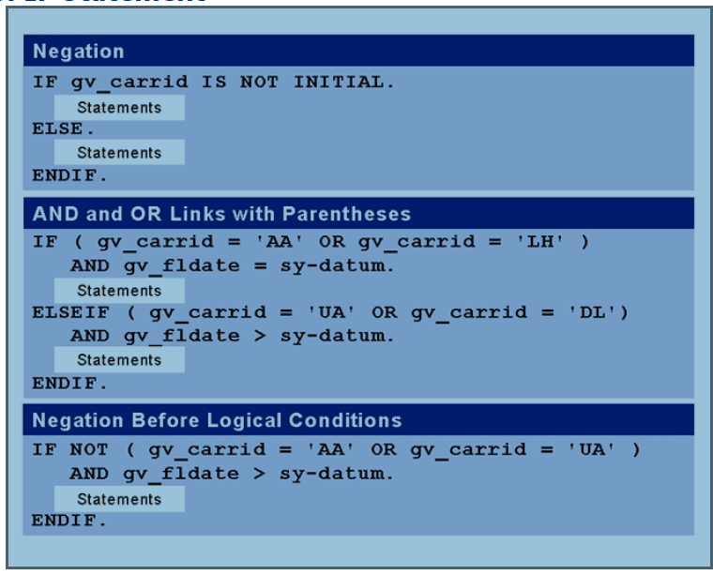
IF statement

Slide 5
Demo
Program on using If Statement

Slide 6
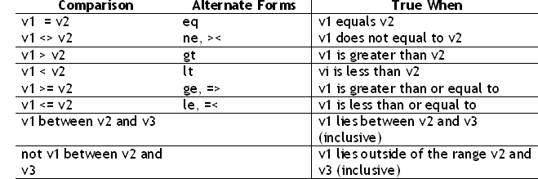
Logical operators for operands of any type
In the above table v1 and v2 can be variables, or literals, or field strings.
In the case of variables or literals, automatic conversion is performed if the data type or length does not match.
Field strings are treated as type c variables.
Notes:
The operators ><, => and =< are obsolete.

Slide 7
Case Statement
The case statement performs a series of comparisons.
Syntax:
case v1.
when v2 [ or vn …].
---
when v3 [ or vn …].
---
[when others.
---]
endcase.
where:
v1 or v2 can be a variable, literal, constant, or field string
--- represents any number of line of code.
Even zero lines are allowed
Notes:
The following points apply:
Only statements following the first matching when are executed
when others matches if none of the preceding whens match
If when others is not coded and none of the whens match, processing continues with the first statement following endcase
Expressions are not allowed
Field strings are treated as type c variables

Slide 8
Case Statement
case is very similar to if/else.
The only difference is that on each if/elseif, you can specify complex expression.
With case, you can specify only a single value to be compared, and values are always compared for equality

Slide 9
Demo
Program on using case Statement

Slide 10
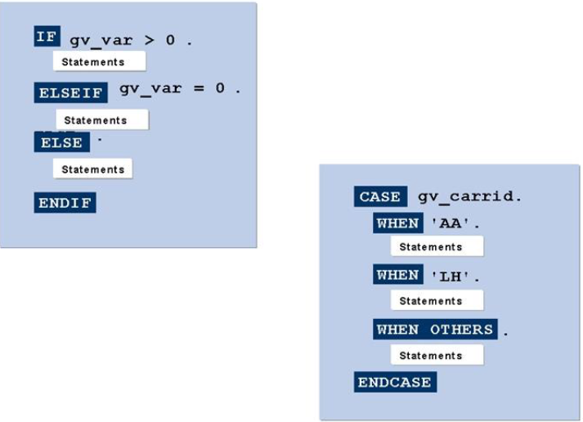
IF and Case statement
Conditional Branches

Slide 11
Exit statement
The exit statement prevents further processing from occurring.
Syntax:
exit.
The following example shows a sample program using exit.
report zdemo506.
write: / ‘Hi’.
exit.
write: / ‘There’.
The above code produces this output:
Hi
Notes:
Exit can be used in many situations. It can have varying effects depending on where it appears in the code. However, it always prevents further processing. Within a loop structure, it leaves loop processing introduced by statements such as loop, select, do, and while. Within subroutines, it leaves subroutines introduced by FORM.

Slide 12
Demo
Program on using Exit Statement

Slide 13
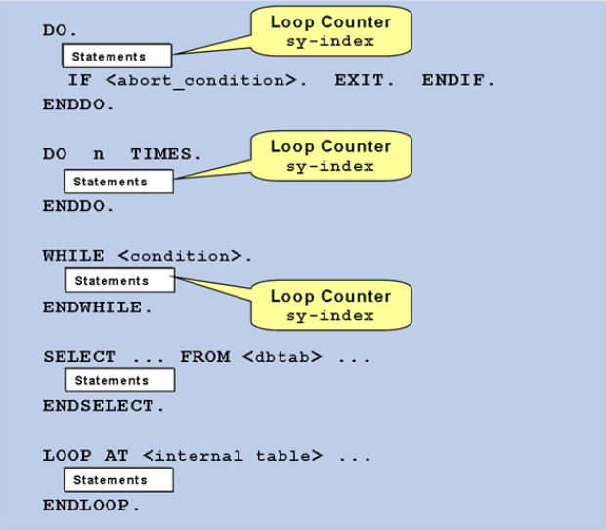
Loops
Unconditional loops using the DO…..ENDDO.
Conditional Loops Using the WHILE ….ENDWHILE.
Loops through Internal Tables using the LOOP….ENDLOOP.
Loops through datasets from database Tables using the SELECT ......ENDSELECT

Slide 14
Do statement
Syntax:
do [ v1 times]
----
[exit.]
----
enddo.
where:
v1 is a variable, literal, or constant
---- represents any number of lines of code
Notes:
The following points apply:
do loops can be nested an unlimited number of times
exit prevents further loop processing and exits immediately out of the current loop.
It does not terminate the program when inside of a do loop. Processing continues at the next executable statement after the enddo
You can create an infinite loop by coding without any additions. In that situations, use exit within the loop to terminate loop processing
Modifying the value of v1 within a loop does not affect loop processing
Within the loop, sy-index contains the current iteration number.
For example, the first time through the loop, sy-index will be 1.
The second time through, sy-index will be 2, and so on.
After enddo, sy-index contains the value it had before entering the loop.
With nested do loops, sy-index contains the iteration number of the loop in which it is used

Slide 15
Using the while Statement
The while statement is a looping mechanism similar to do.
Syntax:
while
------
[exit.]
----
endwhile
Notes:
The following points apply:
while loops can be nested an unlimited number of times and also be nested within other type of loop
exit prevents further loop processing and exits immediately out of the current loop. Processing continues at the next executable statement after endwhile
Within the loop, sy-index contains the current iteration number. After endwhile, sy-index contains the value it had before entering the loop. With nested while loops, sy-index contains the iteration number of the loop in which it is used
endwhile always copies the value of f1 back into the sending component

Slide 16
Demo
Program on Loops – Do and While

Slide 17
Loops
Terminating Loops
Terminating Loop Pass Unconditionally
CONTINUE
EXIT
Terminate Loop Pass Conditionally
CHECK

Slide 18
Continue Statement
The continue statement is coded within a loop.
It acts like a goto passing control, immediately to the terminating statement of the loop and beginning a new loop pass.
In effect, it causes the statement below it within the loop to be ignored and a new loop pass to begin.

Slide 19
Continue Statement
Syntax:
It can be used within a do, while, select, or loop.
[do/while/select/loop]
---
continue.
---
[enddo/endwhile/endselect/endloop]
where:
--- represents any number of lines of code
Notes:
The following points apply:
continue can only be coded within a loop
continue has no additions

Slide 20
Example: Continue statement
The continue statement jumps to the end of the loop, ignoring all
statements after it for the current loop pass.

Slide 21
Demo
Program on continue statement

Slide 22
Check Statement
The check statement is coded within a loop.
It can act very much like continue, passing control immediately to the terminating statement of the loop and bypassing the statements between.
Unlike continue, it accepts a logical expression.
If the expression is true, it does nothing.
If it is false, it jumps to the end of the loop

Slide 23
Check Statement
Syntax:
It can be used within a do, while, select, or loop.
[do/while/select/loop]
---
check exp.
---
[enddo/endwhile/endselect/endloop]
where:
exp is a logical expression
--- represents any number of lines of code

Slide 24
Check Statement
The check logic_expr statement has the following effect:
Outside a loop, you can terminate a processing block prematurely.
The block statements after the check statement are skipped if the logical condition is not fulfilled (false).
The system then continues with the first statement in the next processing block
Within a loop, it has the effect that the next loop is processed.

Slide 25
Check Statement
The check statement is a conditional continue statement.
It jumps to the end of the loop, if the logical expression is false.
If the expression is true, it does nothing.
If it is false, it jumps to the end of the loop

Slide 26
Demo
Program on check statement

Slide 27
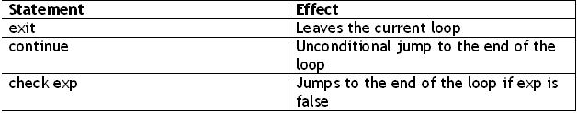
Comparing the exit, continue, and check Statements

Slide 28
Summary
In this lesson, you have learnt:
If Statement and Case Statement
The exit Statement
The do and the While statement
The continue and Check statement

Slide 29
Review Question
Question 1: In a case statement a complex expression can be compared
True/False
Question 2: The ____ statement leaves the current loop.

